Slide 1
EXPERIENTIAL LEARNING
BRANCH
Computer Science and Engineering
TOPIC
Making OS from Scratch
Sahil Santosh Naik
1RV22CS169
Sai Varun Konda
1RV22CS171

Slide 2
Introduction
Table of Contents
Introduction
2. Synopsis
3. Methodology
4. Code
5. Conclusion
6. References

Slide 3
Introduction
Problem Statement :
Design and implement a minimal operating system capable of performing basic tasks such as process management, memory management, and file system
operations. The operating system should be able to boot on standard PC hardware and provide a command-line interface for user interaction. Key functionalities to include bootstrapping, VGA, grub, memory management
PCI.
Tools Used :
QEMU , NASM , BUILD ,
GCC, VSCODE, MAKEFILE

Slide 4
Introduction-Continuation
GOALS:
To build an basic cli interface os
It should have basic grub control
Is should perform basic functions such as printing,reading.
Drivers such as keyboard.
PCI

Slide 5
Synopsis
This project involves building a basic operating system from scratch using a simple language assembly, Using computers interact with hardware. setting up basic tasks like showing text on the screen, handling keyboard inputs, and waiting for certain actions. create a map for the computer's memory called the Global Descriptor Table (GDT), which helps organize how the computer stores and retrieves information.
After laying this groundwork, load our operating system into the computer's memory and start running there. From this point, we gradually add more features to our operating system. We create drivers to make sure hardware like keyboards and screens work correctly, add functions for common tasks like copying data, and set up ways to manage memory efficiently. We also configure devices plugged into the computer, handle interruptions, and manage processes like running different programs.
Ultimately, this project guides us through building a fully functional operating system step by step, teaching us how computers handle basic and advanced tasks along the way.

Slide 6
Methodology
Step 1: Basic BIOS Interrupt Functionalities
- Printing on TTY: Use BIOS interrupt 0x10 for text output.
- Reading in Assembly: Use interrupt 0x16 for keyboard input.
- Waiting: Utilize interrupt 0x15, AH=0x86 for waiting.
- Changing Video Modes: Use interrupt 0x10, AH=0 for text mode and AH=0x12 for VGA.
Step 2: Creating GDT
- Define GDT segments for code, data, stack.
- Load GDT using LGDT instruction.
Step 3: Loading Kernel and Handing Over Control
- Load kernel at 0x1000.
- Jump to kernel entry point for control transfer.

Slide 7
Methodology-Continuation
Step 4: Kernel Functionalities
- Develop drivers for hardware.
- Implement standard library functions.
- Create memory allocation routines.
- Configure PCI devices.
- Handle interrupts.
- Manage processes.
- Develop networking.
- Implement kernel debugging.
- Enforce security measures.

Slide 8
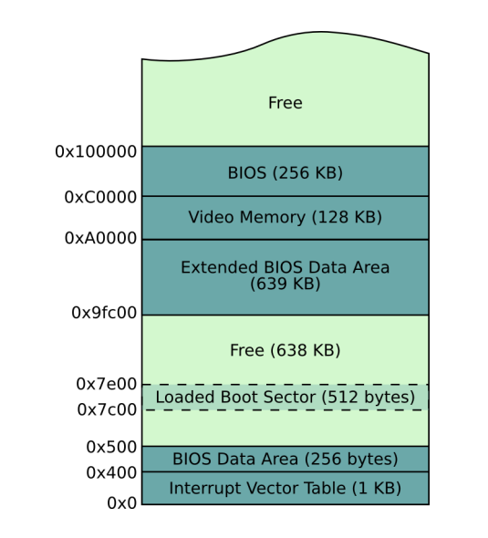
Memory Management

Slide 9
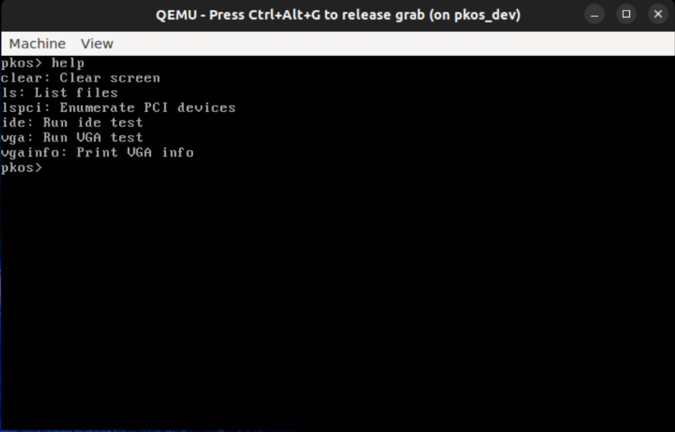
Implementation
Execution:
defines functions for printing characters and strings to the screen, utilizing assembly for efficient memory access. It includes functionalities for printing characters at specific positions on the screen, managing cursor position, clearing the screen, handling newlines and backspaces, and printing prompts and messages.
The assembly function print_char_with_asm calculates the memory offset for printing characters directly to video memory, optimizing performance. Overall, these functions form the foundation for text-based interaction in the PageKey Operating System (PKOS) project

Slide 10
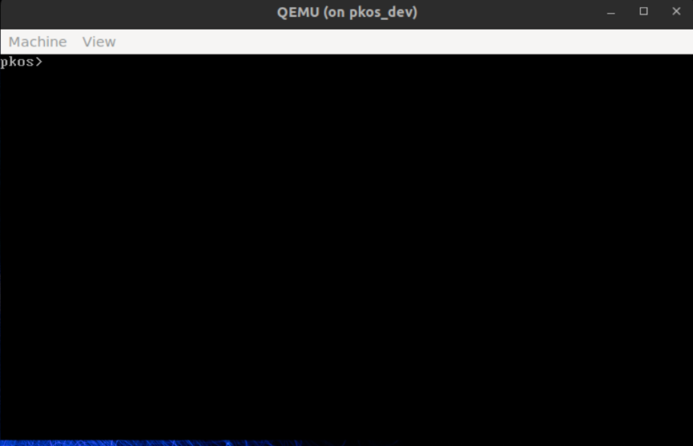
Implementation
Execution:
Initializes the PageKey Operating System (PKOS) kernel, configuring the Interrupt Descriptor Table (IDT) to handle keyboard interrupts. It sets up the IDT entry for the keyboard interrupt (IRQ1) and initializes the Programmable Interrupt Controllers (PICs) to manage interrupt requests.
The handle_keyboard_interrupt() function is called whenever a keyboard interrupt occurs, processing key presses and executing corresponding commands. The main function initializes the kernel, sets up interrupt handling, and enters a loop to handle interrupts indefinitely. Overall, this code forms the core functionality for keyboard interaction in the PKOS kernel.

Slide 11
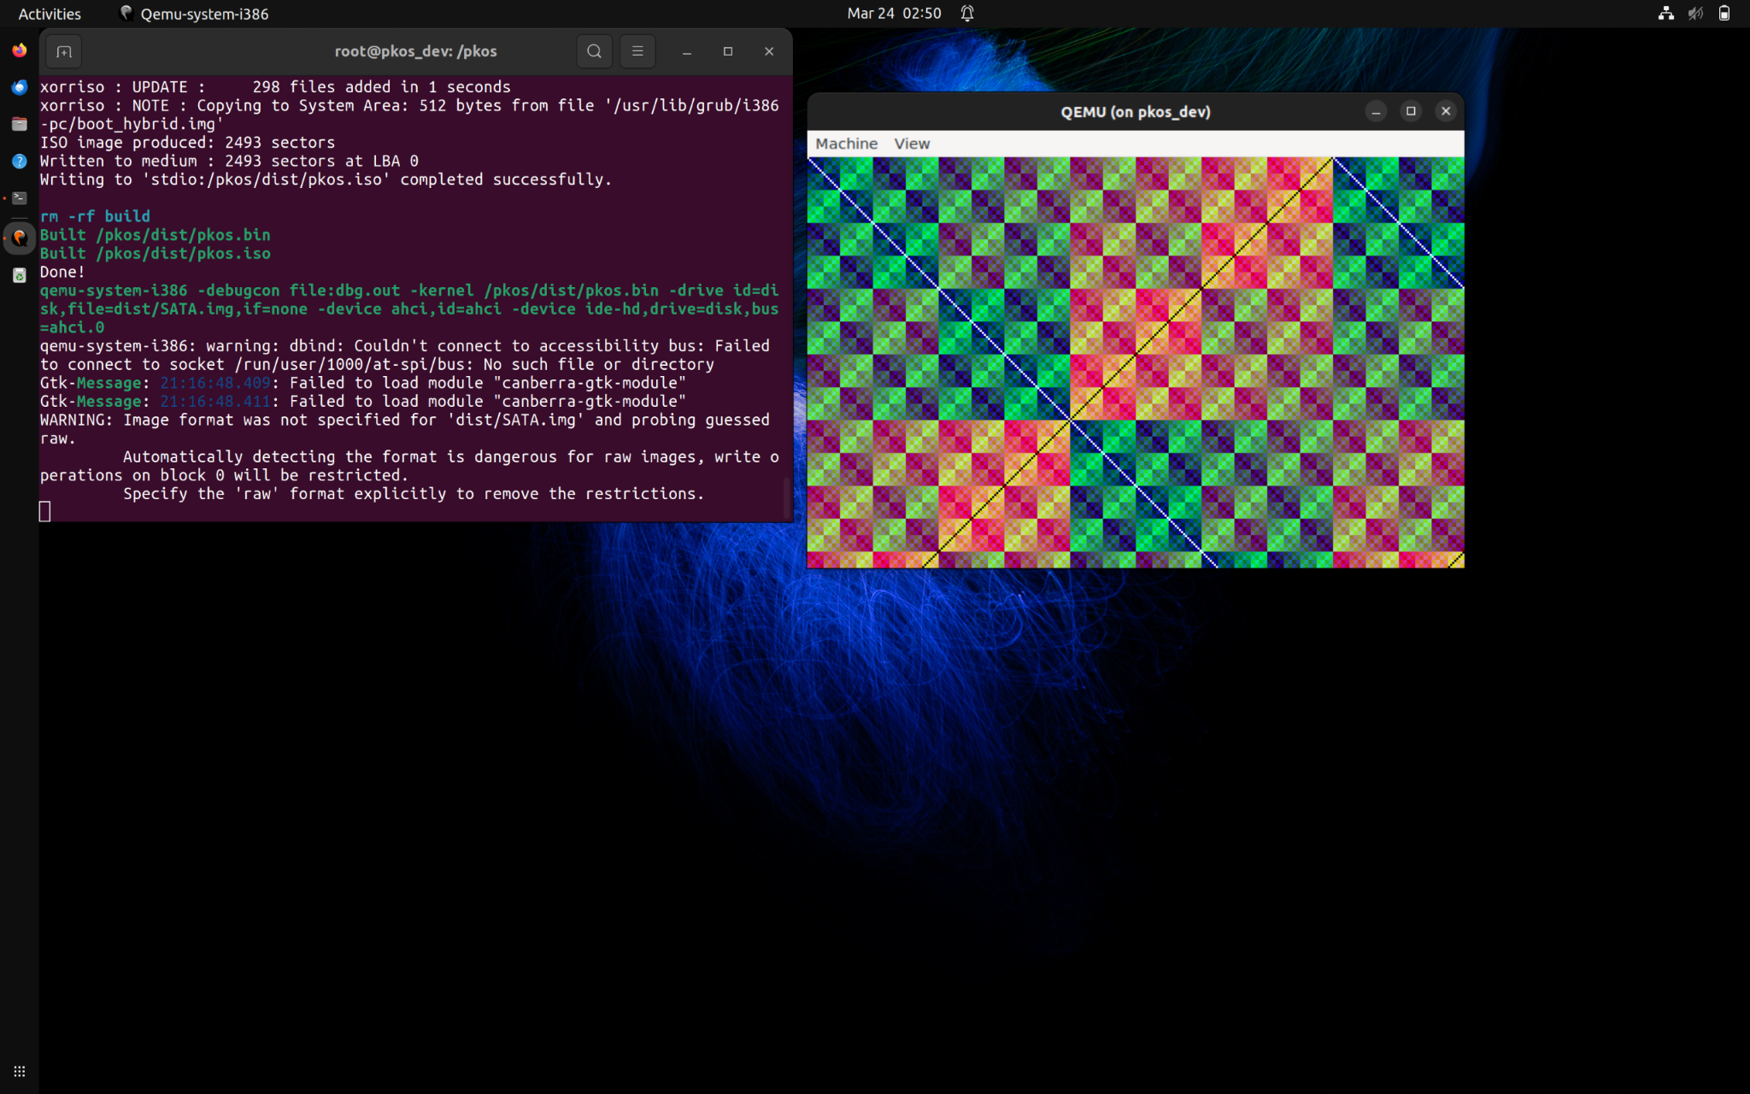
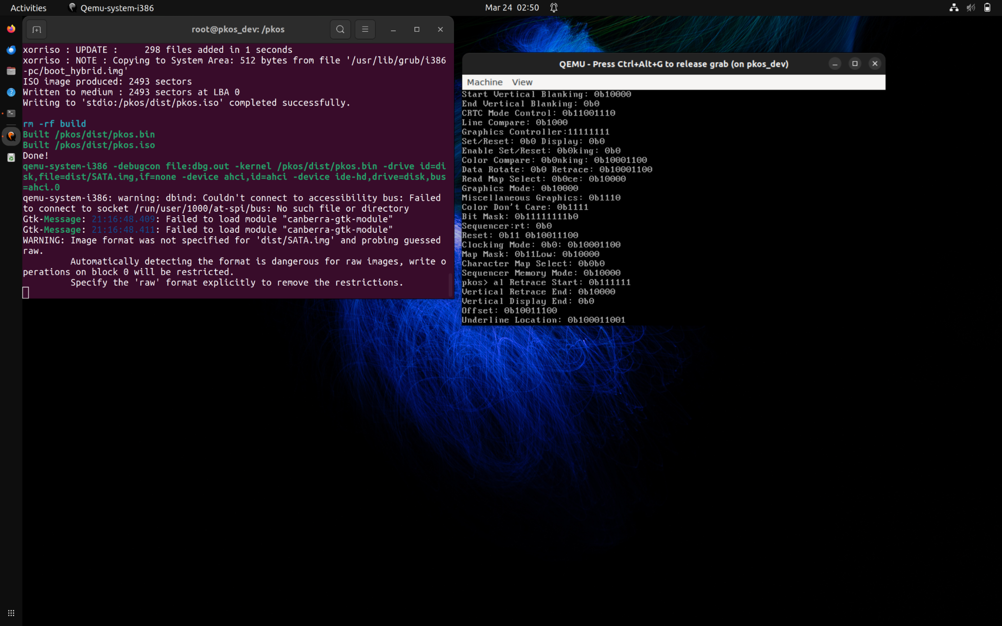
Implementation
VGA:
The VGA implementation in this repository comprises files for register access (reg_.c and reg_.h), VGA configuration (vga_config.c and vga_config.h), and central VGA functionality (`vga.c and `vga.h). VGA hardware, including configuring display modes, managing graphics memory, and controlling the display controller. Overall, the VGA implementation facilitates low-level hardware interaction for display output and control in the PageKey Operating System (PKOS).
LSPCIE:
command within the PageKey Operating System (PKOS) kernel designed to enumerate PCI (Peripheral Component Interconnect) devices connected to the system. This functionality is crucial for hardware detection and device driver initialization, providing users with information such as vendor ID, device ID, class, and other relevant details for each PCI device.

Slide 12
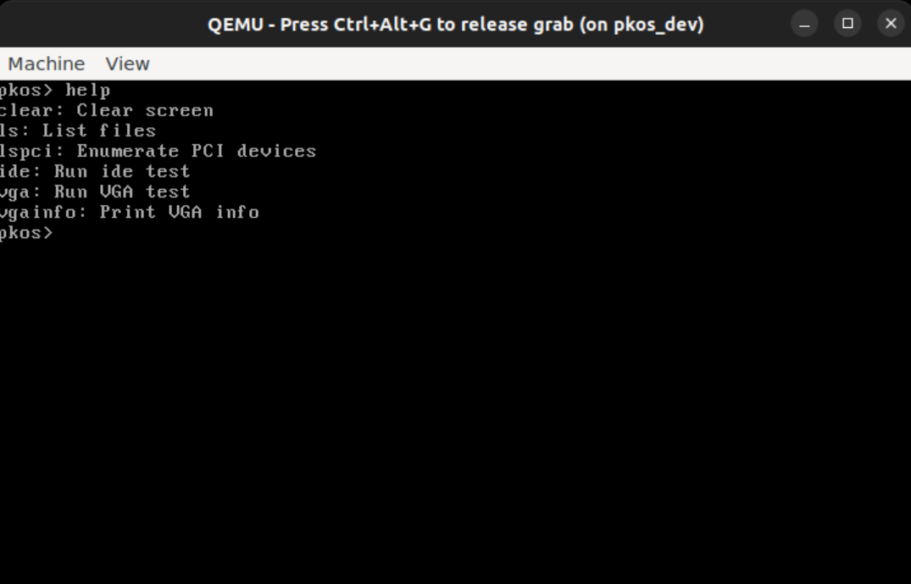
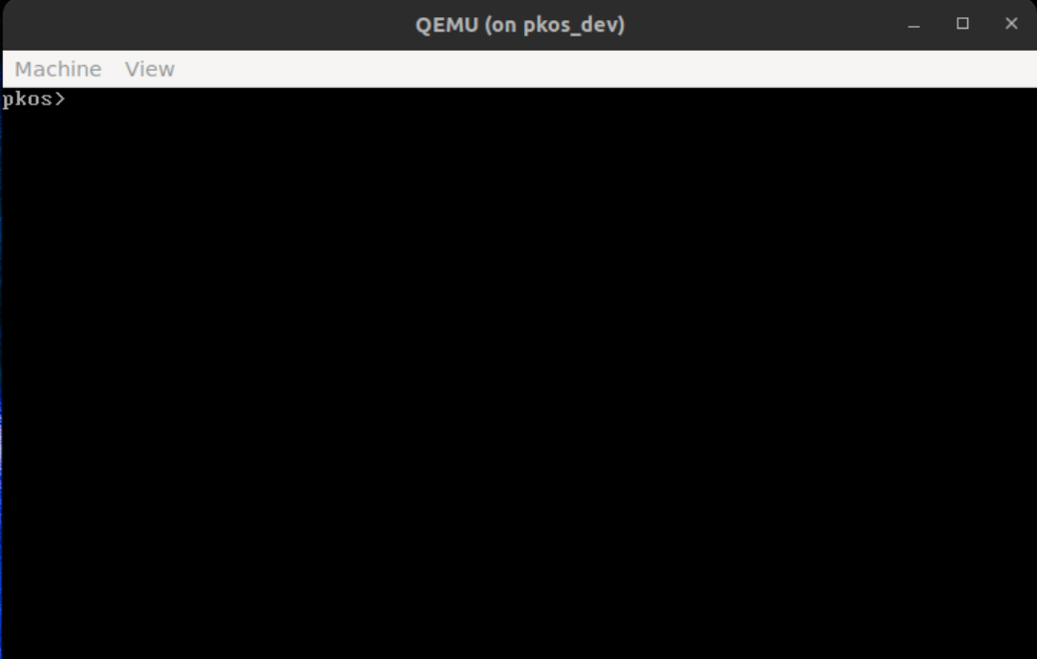
Other Commands:
Help: list of commands that can be used Clear:

Slide 13
Code
include "stdlib.h"
// Base method for itoa
char* _itoa(int integer, char* result, int base) {
int num_digits = 0;
int val = 0;
// Push each digit
while (integer > 0) {
// Mod 10 gets just the last digit
// Adding '0' turns it into an ASCII character
val = integer % base;
if (val < 10) {
result[num_digits] = val + '0';
} else {
result[num_digits] = val + 'a';
}
num_digits++;
// Divide by 10 to get the next character in line
integer /= base;
}
// Reverse it and return it
char tmp = 0;
for (int i = 0; i < num_digits/2; i++) {
// Swap at each end of the array
tmp = result[i];
result[i] = result[num_digits-i-1];
result[num_digits-i-1] = tmp;
}
// Null terminate the string
if (num_digits == 0) {
num_digits = 1;
result[0] = '0';
}
result[num_digits] = '\0';
return result;
}
// Integer to ASCII
char itoa_buffer[256];
char* itoa(int integer) {
return _itoa(integer, *itoa_buffer, 10);
}
// Integer to ASCII HEX
char* itoah(int integer) {
return _itoa(integer, *itoa_buffer, 16);
}
// Integer to ASCII Binary
char* itoab(int integer) {
return _itoa(integer, *itoa_buffer, 2);
}
bool streq(char* string1, char* string2) {
int i = 0;
while (true) {
// Char mismatch? false
if (string1[i] != string2[i]) {
return false;

Slide 14
Code
}
// They're equal, AND it's null char? We're
done
if (string1[i] == '\0') {
break;
}
i++;
}
return true;
}
bool safe_streq(char* string1, int str1len, char*
string2, int str2len) {
if (str1len != str2len) return false;
for (int i = 0; i < str1len; i++) {
if (string1[i] != string2[i]) return false;
}
return true;
}
void terrible_sleep_impl(int ticks) {
volatile int i = 0;
while (i < ticks*100000) i++;
}
GDT
GDT - Global Descriptor Table
gdt_start:
gdt_null: ; Entry 1: Null entry must be included first
(error check)
dd 0x0 ; double word = 4 bytes = 32 bits
dd 0x0
gdt_code: ; Entry 2: Code segment descriptor
; Structure:
; Segment Base Address (base) = 0x0
; Segment Limit (limit) = 0xfffff
dw 0xffff ; Limit bits 0-15
dw 0x0000; Base bits 0-15
db 0x00 ; Base bits 16-23
; Descriptor Privilege level: 0x00 (ring 0)
; Descriptor Type: 0b1 (code/data)
; Flag Set 2: Type Field
; Code: 0b1 (this is a code segment)
; Conforming: 0b0 (Code w/ lower privilege
may not call this)
; Readable: 0b1 (Readable or execute only?
Readable means we can read code constants)
; Accessed: 0b0 (Used for debugging and
virtual memory. CPU sets bit when accessing
segment)
db 10011010b ; Flag set 1 and 2
; Flag Set 3
; Granularity: 0b1 (Set to 1 multiplies limit by
4K. Shift 0xfffff 3 bytes left, allowing to span full
32G of memory)
; 32-bit default: 0b1

Slide 15
Code
; 64-bit segment: 0b0
; AVL: 0b0
db 11001111b ; Flag set 3 and limit bits 16-19
db 0x00 ; Base bits 24-31
gdt_data:
; Same except for code flag:
; Code: 0b0
dw 0xfffff ; Limit bits 0-15
dw 0x0000; Base bits 0-15
db 0x00 ; Base bits 16-23
db 10010010b ; Flag set 1 and 2
db 11001111b ; 2nd flags and limit bits 16-19
db 0x00 ; Base bits 24-31
gdt_end: ; Needed to calculate GDT size for
inclusion in GDT descriptor
kernel
bits 32
section .multiboot
dd 0x1BADB002 ; Magic number
dd 0x0 ; Flags
dd - (0x1BADB002 + 0x0) ; Checksum
section .text
; Include the GDT from previous tutorials
; Set this as our GDT with LGDT
us
%include "src/kernel/gdt.asm"
; Make global anything that is used in C files
global start
global load_gdt
global load_idt
global keyboard_handler
global ioport_in
global ioport_out
global inl
global outl
global enable_interrupts
extern main ; Defined in kernel.c
extern handle_keyboard_interrupt
load_gdt:
mov ss, ax
mov esp, stack_space ; set stack pointer
cli ; Disable interrupts
mov esp, stack_space
call main
hlt
section .bss
resb 8192 ; 8KB for stack
stack_space

Slide 16
Conclusion
In overall view we have build os with functionalities such as booting up with tty mode and doing operation in text and vga made using bios interrupts. Later part we loaded kernel at location 1000. Then using function in c code we configures rgb values and vga attributes. We have configured pci, displayed the pci device values.

Slide 17
References
Writing a Simple Operating System — from Scratch by Nick Blundell
OSDEV.org

